Slide 1
Vertical Slice Architecture

Slide 2

Not a software company
90 repositories
51 automated deployments
6 developers
Notes:
Our developers have a mixed background
When I started, it was most SQL scripts with some VB

Slide 3
ERP
Ecomm
Inbound
Mail
Multiple
Vendors
Direct
Mail
Notes:
Gray = 3rd party sw
Orange = move data
Yellow = web apps for internal or external (data input, reporting, accepting payments, etc)

Slide 4
What We Want
Quick to build
Quick to add or change features
Simplicity
Use industry knowledge
Notes:
We build software mostly for internal users. We want to get something up in as little as a week.
We want it to be easy to add features. Sometimes our apps sit with no work, sometimes apps are not finished due to business reasons, sometimes apps grow quickly or change rapidly.
Don’t want to be dependent on enterprise knowledge.

Slide 5
The Problem
Notes:
Code Example #1: Contoso University
Controllers, Views, Models are scattered about (refactoring requires jumping around)
Persistence models as action arguments (white labeling = bad for renaming, bad for security due to overposting)
Persistence models as view models (quick UI divergence => refactoring headaches)
Complex controllers with all business logic in the actions + dependence on services makes testing hard (complexity + large services => needs tests)
Code Example #2: nopCommerce
Complex controllers lead to shared services -> Complexity gets pushed down but is still complex
Cannot test individual methods without faking out all service dependencies

Slide 6
Layering
Presentation Layer
Business Logic Layer
Data Access Layer
Notes:
Classical architecture focuses on horizontal layers, n-tier, onion, hexagonal.
They don’t help us structure our application. They add abstraction.
From the start, have to use DTOs and lots of mapping.
THINK: What benefits are we trading for this added complexity? Is there a better way?

Slide 7
Loose coupling requires abstractions.
Abstractions are complexity.
Notes:
This is the guiding message of this presentation and vertical slice architecture.
This is the tradeoff we make in every application we build.
The default, classical architecture pushes loose coupling...complexity.
In this talk, we are going to tear down the orthodoxy and think pragmatically.
Languages and tooling have changed a lot in recent years.

Slide 8
Vertical Slice Architecture
Presentation Layer
Presentation Layer
Feature
Feature
Business Logic Layer
Feature
Feature
Feature
Data Access Layer
Data Access Layer
Notes:
Let’s start with n-tier architecture.
You can use onion, hexagonal, or any other architecture that pushes horizontal layering.
VERTICAL SLICING!
Split it into features (in DDD, these are generally your aggregates).
THEN minimize coupling between feature slices (natural)
WHILE maximizing coupling between horizontal layers (reduce complexity)

Slide 9
Implementing
Vertical Slice Architecture

Slide 10
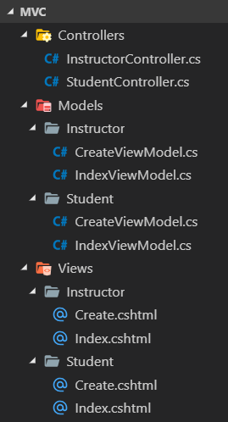
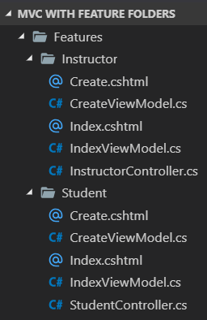
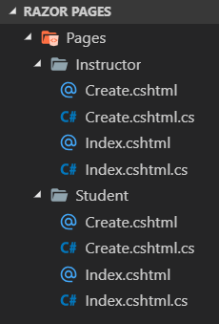
Feature Folders
NuGet Package
OdeToCode.AddFeatureFolders
Notes:
Step 1: Rearrange project
Controllers/actions, views, and view models all in one place. Makes working in the project easier. Fits vertical arch very well.
With MVC, use OdeToCode.FeatureFolders nuget package
Razor pages provides a similar structure (default in VS2019)
Even if you don’t use vertical slicing, please use feature folders

Slide 11
Commands
Queries
Authentication
Command Validation
Domain Validation & Updates
Domain Events ?
Database Updates
Authentication
Database Queries
Caching
Projection to View Models
Notes:
We want Single Responsibility w/ very narrow workflows.
Since commands & queries have different flows and very different needs, split them.
Queries no longer need to take a dependence on the domain models or services in the business layer (next slide)

Slide 12
Queries
Web App
(PL)
Entity
Framework
(DAL)
Query
DbContext
Domain
(BLL)
Aggregate Root
return _db.Customers.ProjectToAsync<GetCustomerViewModel>();
Notes:
With max coupling, queries are really simple.
You can use your EF DbContext directly from the query handler. - no need to write a unit test for it.
--CLICK--
Query handler is very simple. No abstractions. Can use the DbContext directly.
Use Automapper’s ProjectToAsync to auto generate exactly the SQL we need to populate our view model.

Slide 13
Commands
Web App
(PL)
Entity
Framework
(DAL)
Command
Save
Domain
(BLL)
Aggregate Root
public Guid Create(CreateCustomer.Command command)
Notes:
Commands can be pushed down to the domain.
With EF Core, we can generally have our “models” be our domain models and add Entity Framework as a persistence layer on top.
--CLICK--
The aggregate root can handle the presentation layer command directly. Cannot do with strict dependency of layers. Not a “service dependence”, it is a “data structure dependence”.

Slide 14
Example
Notes:
Contoso University Razor Pages
Project structure
Single project
Simplicity, easy to follow
Easy to add features or change existing

Slide 15
Reduce Reuse
Notes:
Reuse + divergence often adds complexity and creates balls of mud.
Sometimes copy-paste is OK. Don’t DRY just because it’s an easy principal to follow.
Try not to reuse application components until the benefit outweighs the cost.
Push complex logic into the domain.

Slide 16
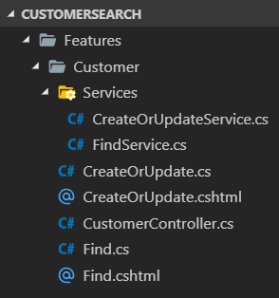
Services
Notes:
Sometimes it makes sense for actions to share service code.
Keep it local to the feature as much as possible.
Better than one big messy Services folder w/ no ownership.

Slide 17
Testing
Notes:
Feature actions may be simple enough to no longer need testing.
Complex feature actions -> push to domain layer which as easy to test.
.NET Core makes it really easy to test controllers (DI, EF in-memory persistence).
Fake/mock only services outside of the app you are testing.

Slide 18
Cross Application Slicing
App 1
App 2
Common API
Method
Notes:
We can apply a similar vertical concept across application boundaries.
Consider an API that is consumed by multiple apps.
Sharing one API method can cause refactoring problems as the consumers diverge.

Slide 19
Cross Application Slicing
App 1
App 2
Common API
App1Controller
App2Controller
Method
Method
Notes:
Instead, it often makes sense to split the API into one Controller or Area for each consumer.
Handling divergence is easier. Only need to change the one method and one application.
Reduces need for versioning.
Does not work with public APIs where you have countless consumers.

Slide 20
Questions?

